Slide 1

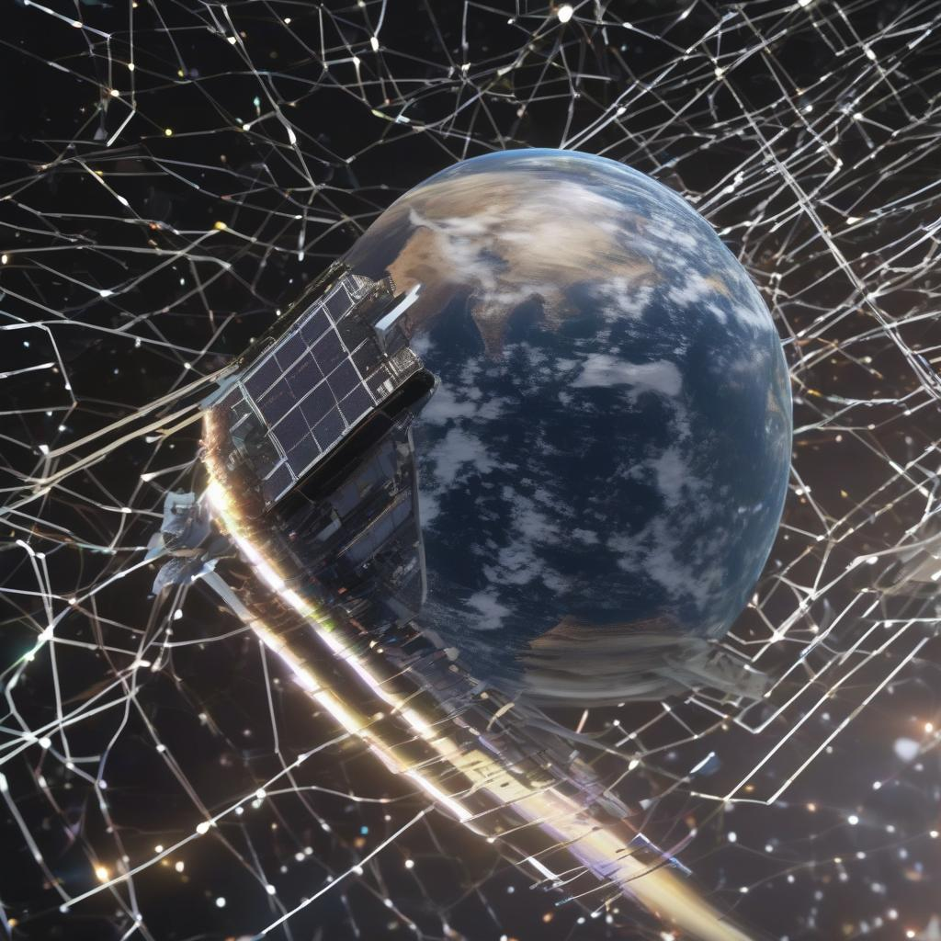
AI-Powered Satellite Imagery Analysis: Introduction
Welcome! This presentation explores the revolutionary potential of AI in real-time analysis of satellite imagery.
We will examine its applications across various sectors, from environmental monitoring to urban planning.
This technology significantly enhances our ability to process and interpret vast amounts of data quickly and efficiently, leading to timely and informed decisions.

Slide 2
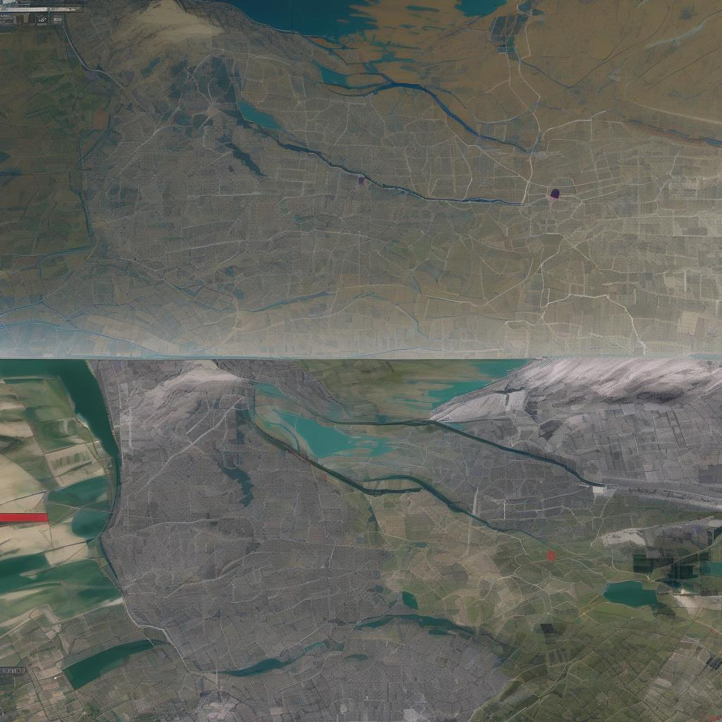
Real-time Processing: The Power of Speed
Real-time analysis is crucial for timely responses to dynamic events.
AI algorithms enable rapid processing of satellite data, allowing for immediate identification of changes and anomalies.
This speed is paramount in disaster response, where quick assessment of damage is essential for efficient resource allocation and rescue operations.

Slide 3
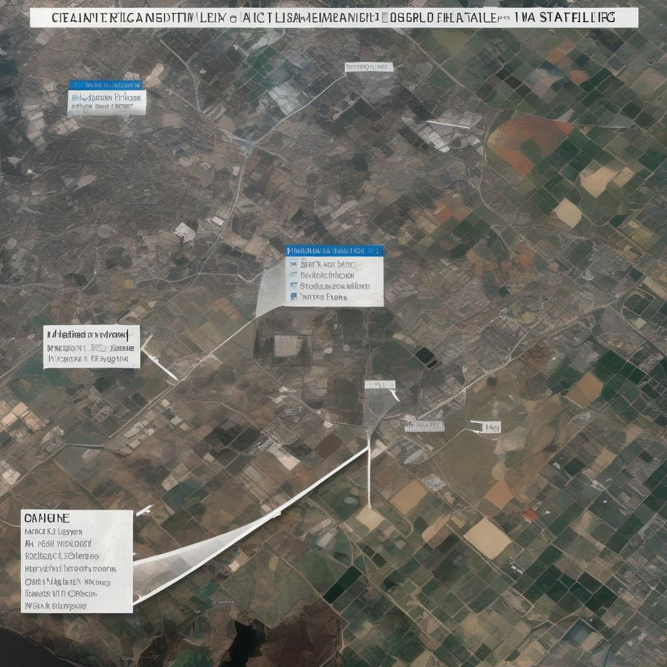
Object Detection and Classification
AI excels at identifying and classifying objects within satellite imagery.
Algorithms can pinpoint specific features like buildings, vehicles, or even individual trees with high accuracy.
This capability is transformative for tasks such as urban planning, deforestation monitoring, and infrastructure management.

Slide 4
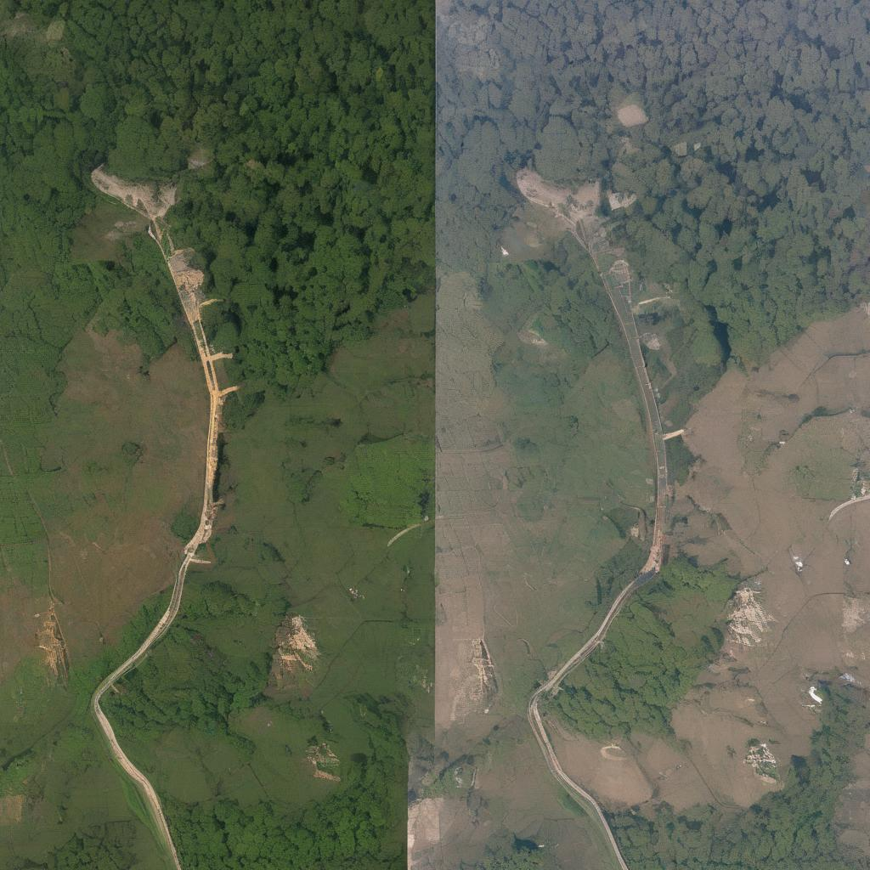
Change Detection: Monitoring Dynamic Environments
AI algorithms efficiently detect changes over time by comparing sequential satellite images.
This is invaluable for tracking deforestation rates, urban sprawl, glacier melting, and other environmental shifts.
Early detection allows for proactive interventions and effective mitigation strategies.

Slide 5
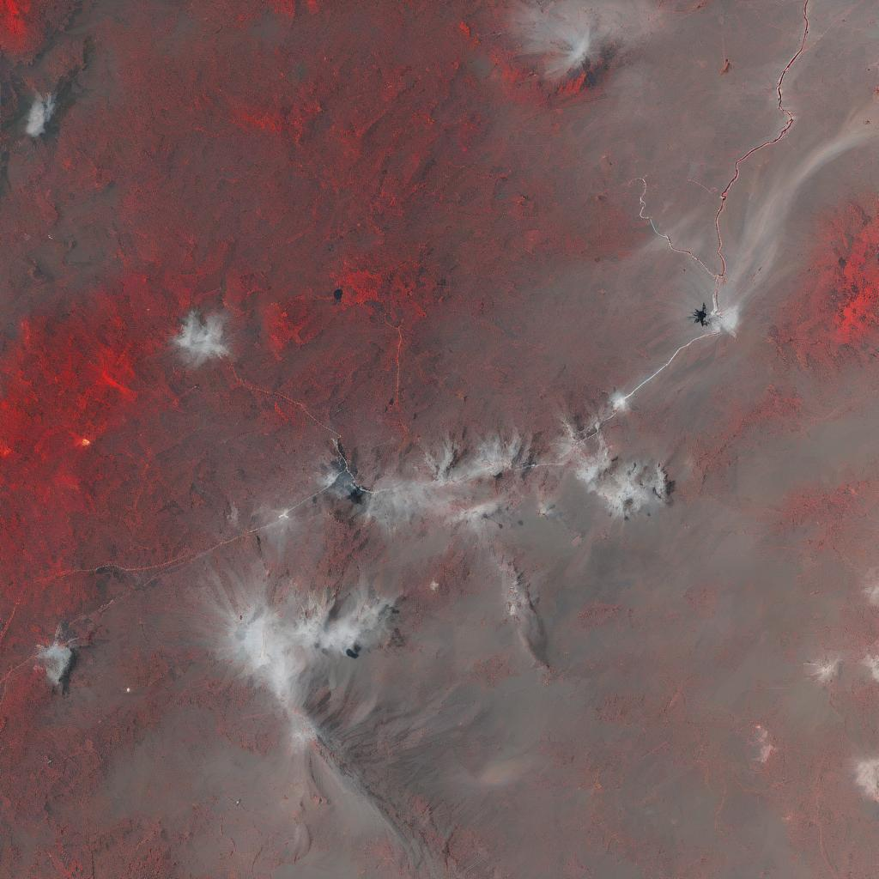
Anomaly Detection: Identifying the Unusual
AI can identify unusual patterns or anomalies that might be missed by human analysts.
This includes detecting unusual activity, infrastructure damage, or environmental hazards.
This capability is vital for security applications, predictive maintenance, and environmental monitoring.

Slide 6
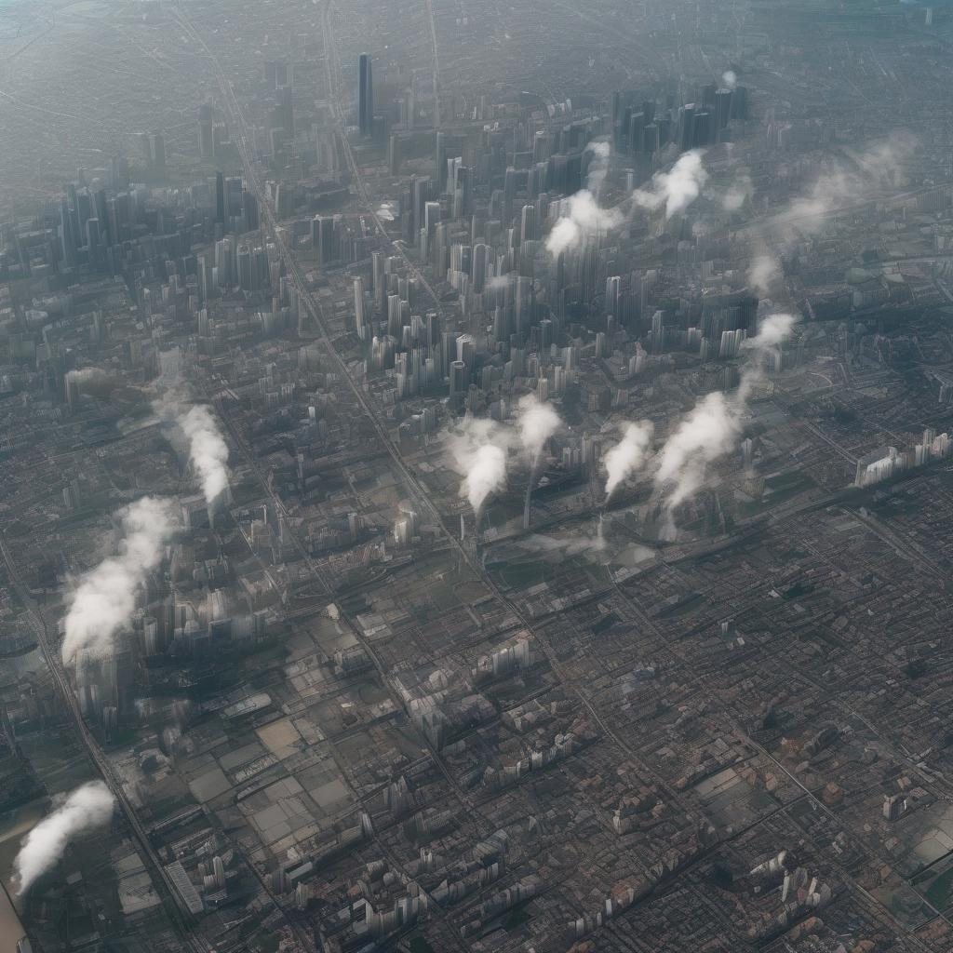
Applications in Environmental Monitoring
AI-driven analysis is revolutionizing environmental monitoring.
From tracking pollution levels to assessing the health of ecosystems, AI provides crucial insights for environmental protection and sustainable resource management.
This allows for data-driven conservation efforts.

Slide 7
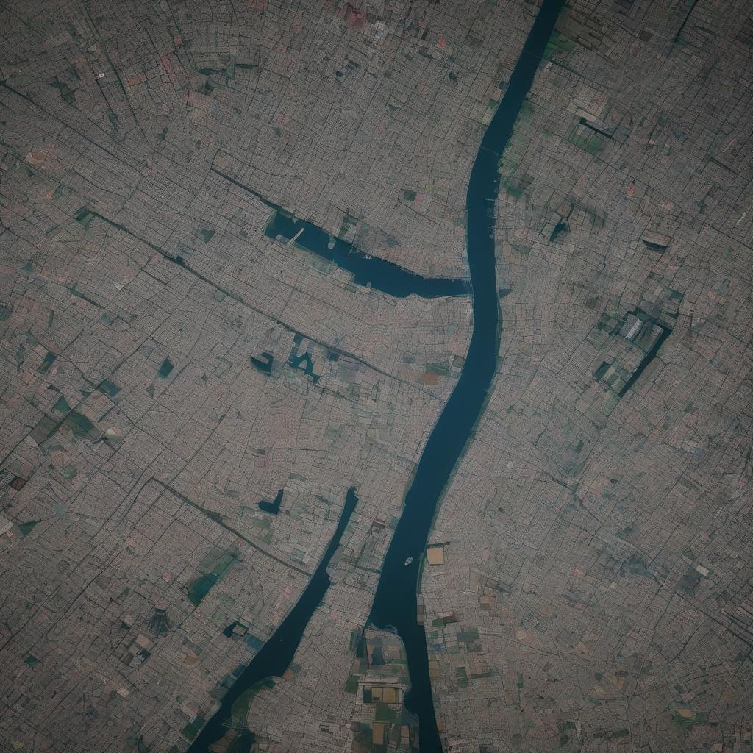
Applications in Urban Planning and Development
In urban planning, AI helps analyze population density, infrastructure needs, and urban sprawl.
This data-driven approach leads to more efficient resource allocation and sustainable urban development.
It also improves infrastructure planning and management.

Slide 8
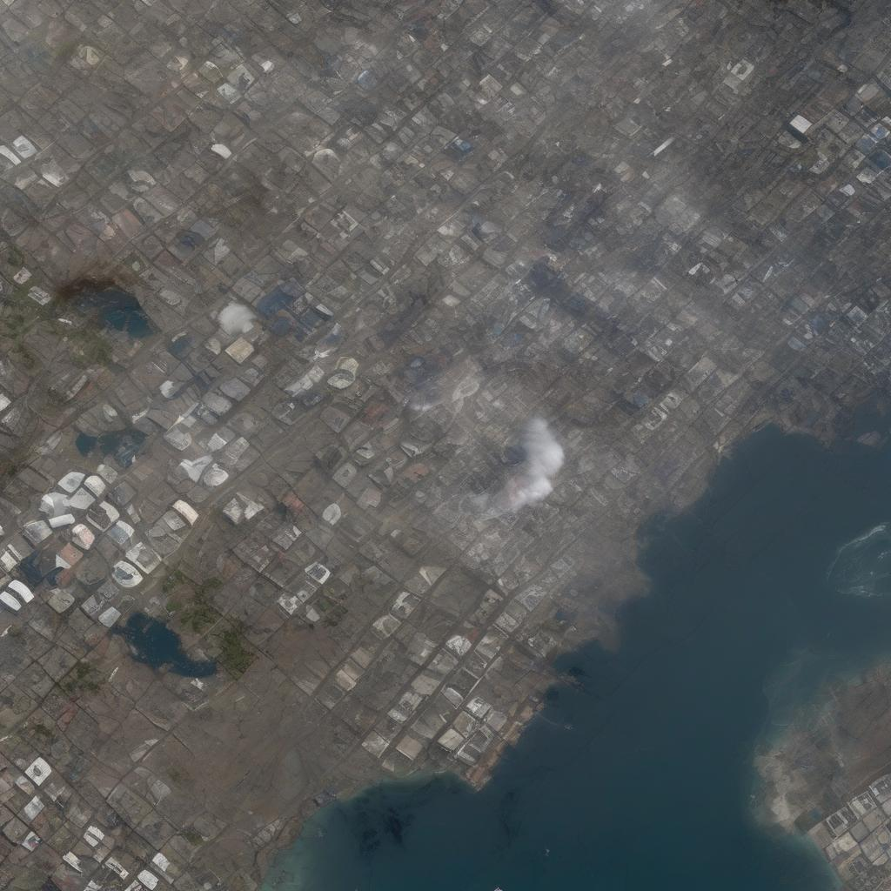
Applications in Disaster Response and Management
Real-time analysis is crucial during disasters.
AI can quickly assess damage, identify areas needing immediate help, and guide rescue operations.
This allows for faster response times and more efficient resource allocation, saving lives and reducing damage.

Slide 9
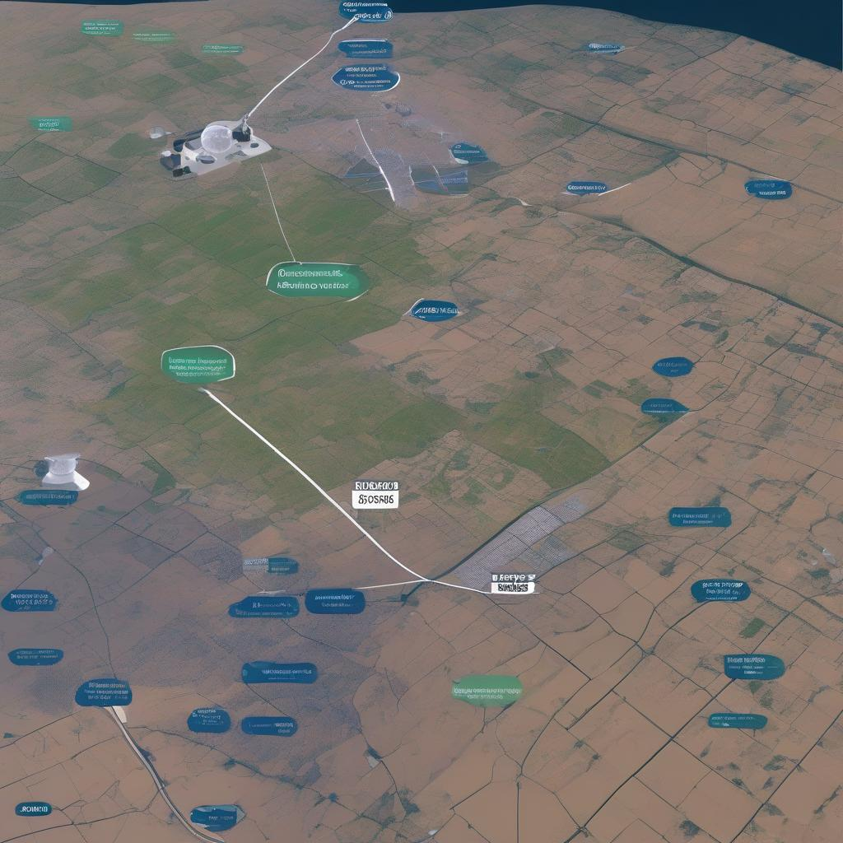
Challenges and Future Directions
Despite its potential, challenges remain.
These include data volume, computational costs, and algorithm biases.
Future research will focus on improving algorithm accuracy, efficiency, and addressing ethical considerations related to data privacy and security.

Slide 10

Conclusion: A Transformative Technology
AI-powered real-time analysis of satellite imagery is transforming various sectors.
Its speed, accuracy, and ability to process vast amounts of data offer unprecedented opportunities for informed decision-making and effective interventions across numerous applications.

